Slide 1

SEMESTER TOPIC
Esta Foto de Autor Desconhecido está licenciado em CC BY
Interactive Analysis of the Main Cargoes Moved and Logistics Comparison between States and Municipalities in São Paulo through a Power BI Dashboard

Slide 2




TEAM MEMBERS
-Ana Beatriz (Scrum Master)
https://www.linkedin.com/in/ana-beatriz-4026082b1?utm_source=share&utm_campaign=share_via&utm_content=profile&utm_medium=android_app
-Filipe Gabriel (Product Owner)
https://www.linkedin.com/in/filipe-gabriel-0047a131a?utm_source=share&utm_campaign=share_via&utm_content=profile&utm_medium=ios_app
-Gabriela Souza
https://www.linkedin.com/in/gabriela-souza-oliveira-8b7139388?utm_source=share&utm_campaign=share_via&utm_content=profile&utm_medium=android_app
-Thamires Thomaz
https://www.linkedin.com/in/thamires-thomaz-7b8409180?utm_source=share&utm_campaign=share_via&utm_content=profile&utm_medium=android_app

Slide 3
PROJECT OBJECTIVE
- Develop an interactive dashboard that displays the main loads handled and allows comparison between states and municipalities in São Paulo, facilitating logistical analysis and supporting strategic decision-making through Business Intelligence tools.

Slide 4
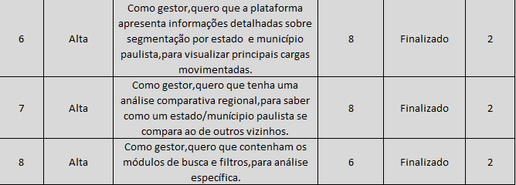
SPRINT 2 BACKLOG

Slide 5
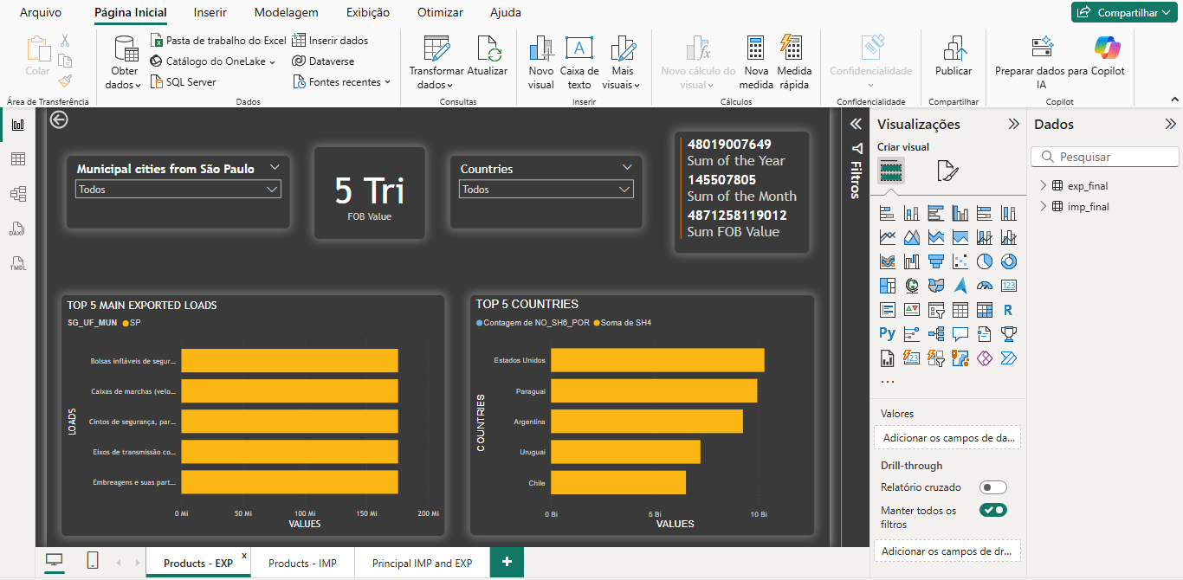

Slide 6
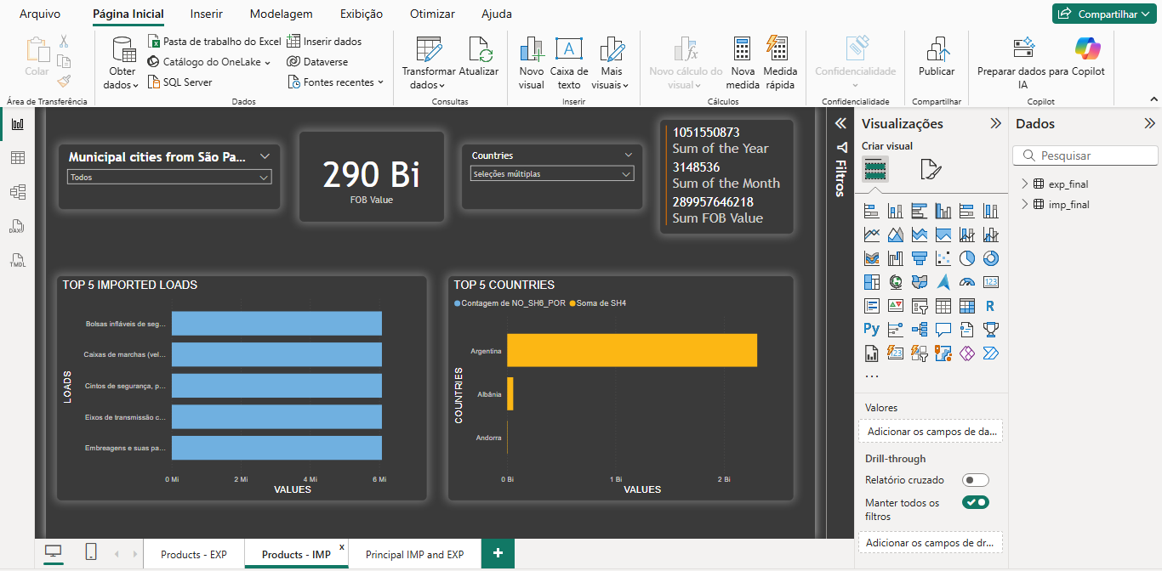

Slide 7
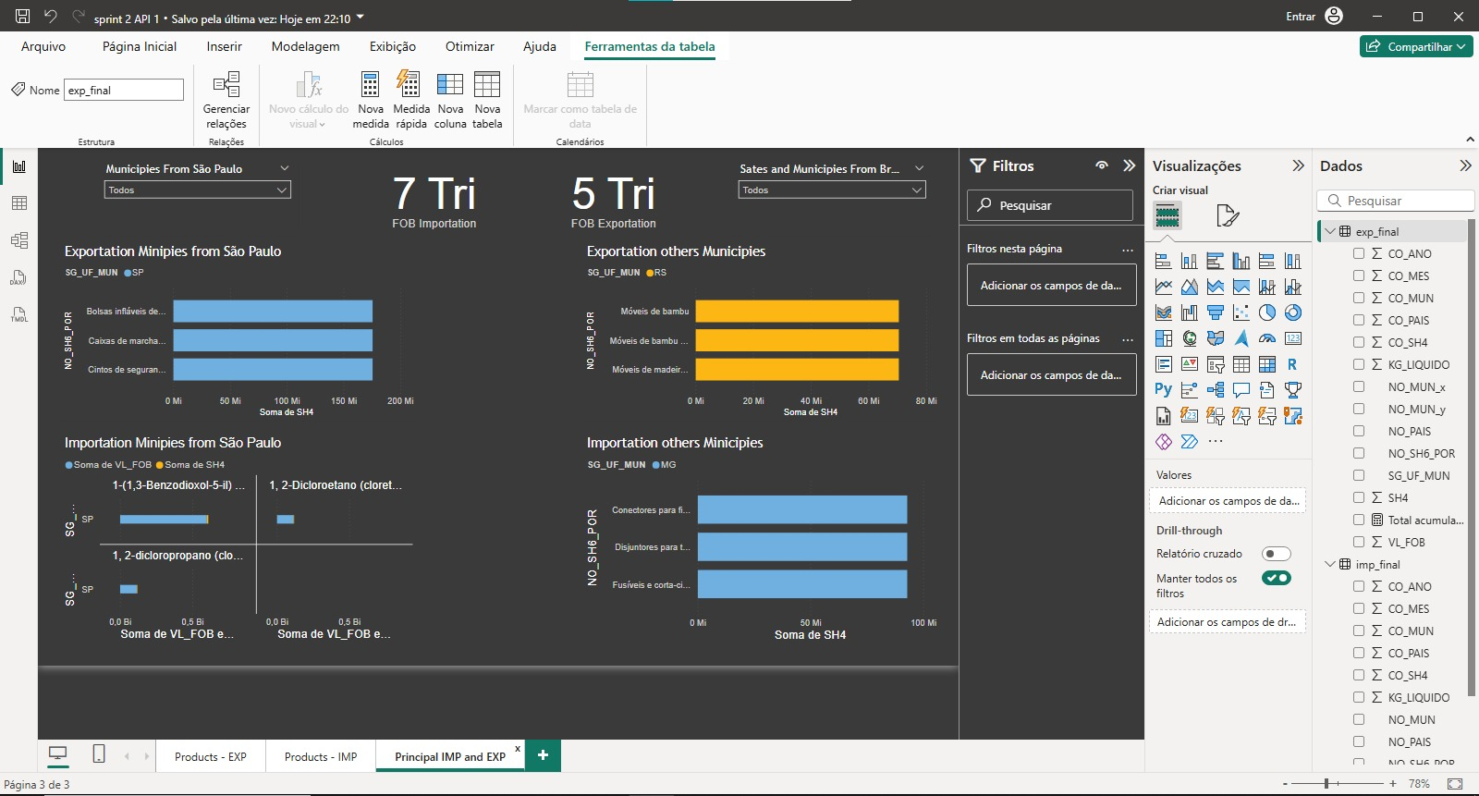

Slide 8

THANK YOU FOR YOUR ATTENTION

